Slide 1
Shipping & Blockchain Seminar
21st November –
Palazzo San Giorgio, Genoa
Hosted by Assagenti
Blockchain Practice in
Maritime Transport
Richard Morton,
Secretary General, IPCSA

Slide 2
Blockchain in Maritime Transport
IPCSA Bill of Lading Proof of Concept
Port of Antwerp ePhyto via Blockchain Proof of Concept
Challenges of Implementation

Slide 3
IPCSA Blockchain Bill of Lading Initiative
Port
Port
BoL Partners
Freight
forwarder
Freight
forwarder
Exporter
Ship
agent
Ship
agent
Importer
Customs
Customs
Bill
of Lading
Confirming
Bank
Issuing
Bank
Direct interaction with the B/L
Transport company
Transport company
Interaction with derivatives of the B/L

Slide 4






IPCSA Blockchain Bill of Lading Initiative
BC BoL High Level Business Flow
Export Country
Issue BoL
Exporter
Ship
agent
BoL
Forward BoL
PCS1
Advising bank
Approve BoL
Users
Validators
Interact through Web Application
Smart Contract
Endorse BoL
Have a network node
Issuing bank
Submit BoL
PCS2
Issue Delivery Order
Ship
agent
Importer
DO
Import Country

Slide 5
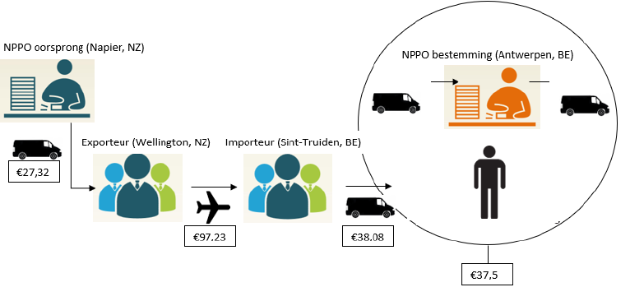
Phytosanitary certificate – current flow
A declaration used in international commerce for shipments of plants and plant products.
Certificate issued by the National Plant Protection Organisation of the exporting country to be presented to the NPPO of the importing country.
Source: “Digitizing the phytosanitary certificate” by C. Peeters (2018)

Slide 6
ePhyto exchange via Blockchain
Proof of Concept was set up for a specific apple trade
between New Zealand (Port of Napier) and the Port of Antwerp
PoC builds further upon Smart Contract building blocks, on top of the basic blockchain technology
Executed during June - August 2018
(launched on June 14th)

Slide 7
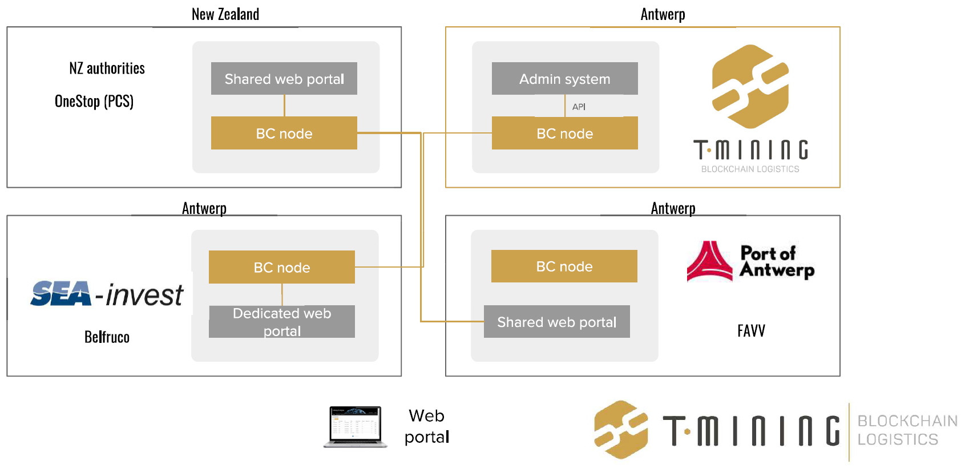
Pilot case – blockchain infrastructure (1)

Slide 8
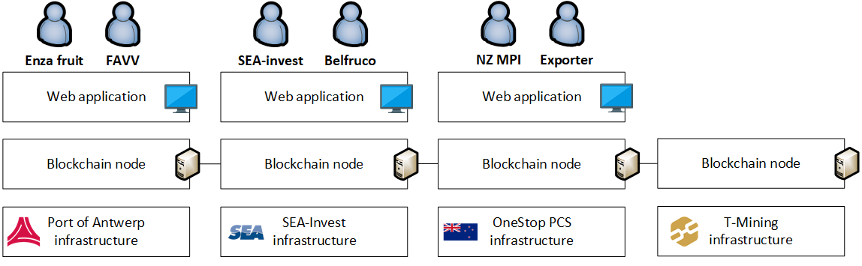
Pilot case – blockchain infrastructure (2)

Slide 9
Challenges of Implementation
Technology
Technology maturity - Long transaction confirmation time (Affected by parameters such as Smart contract complexity, validators number, the technology used, etc)
Lack of expert developers with work experience in several projects already working
Interoperability of Blockchain networks- number of co-existing solutions

Slide 10
Challenges of Implementation
Regulations/Standards
• Legal recognition – carriers, Insurance companies, banks and countries are required to adopt new regulations.
• Data ownership, personal privacy, general data protection regulation.
• Missing open standards - Data Definitions should comply with currently used international standards (maritime industry is
UN/EDIFACT and the Core Component Library of UN/CEFACT).
• Multiple players with different technology adoption.

Slide 11
Challenges of Implementation
Other obstacles
• Need to change business processes
• Creation of EcoSystem on both sides of the ocean
• Using blockchain only when needed

Slide 12
Opportunities of Implementation
• increases transparency , availability and reliability for all participants. (Enables traceability and preventing manipulation through the public auditability of the system, Sharing an updated information (container loading, verifies a vessel has actually departed)
• More efficient transfer of digital assets (Blockchain digital transfer of assets could provide the benefits of quick transfer, and security to both parties)
• Increased security

Slide 13
Opportunities of Implementation
• Automation of contractual obligations through Smart Contracts (The exchange of goods against payment process is handled through different financial and physical flows. These two flows can be synchronized if both assets exist in a digital form. Swapping of assets can happen through smart contracts)
• Time and cost reductions
• Using blockchain only when needed

Slide 14



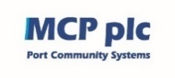







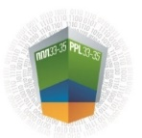

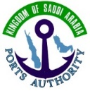















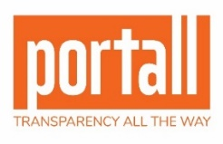






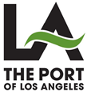
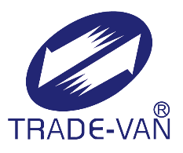
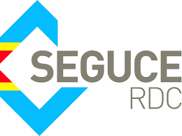



Richard Morton, IPCSA, Secretary General
E: richard.morton@ipcsa.international
Associate Members

